Slide 1

Transforming Advisor support Inboxes with AI
Our vision: Today we automate email drudgery. Tomorrow we are the operating system of trusted AI workflows across every advisor supports' inbox.

Slide 2
The Daily Email Burden
Thousands of Requests
Manual Processing
High Turnover
Middle-office emails flood advisors' Outlook inboxes daily requesting client data, presentation decks, proposal drafts, onboarding forms, compliance updates, and ad-hoc research.
Advisor Support Specialists manually read, classify, and copy-paste data between multiple systems—burning 4–6 hours per complex request.
This tedious work drives 18% annual turnover among support staff.

Slide 3

Key Challenges for Leadership
Executive Directors
Lack real-time visibility into ticket queues, SLA risk, or individual workloads across 180-person teams, leading to frequent firefighting and missed deadlines.
Head of Advisor Support
See inconsistent client service, rising labor costs, and limited proof of the operational ROI demanded by regulators and the board.

Slide 4

Our Solution: Intelligent Outlook Layer
A secure, AI-powered platform that sits on top of Microsoft Outlook and transforms unstructured email chaos into fully automated workflows.

Slide 5
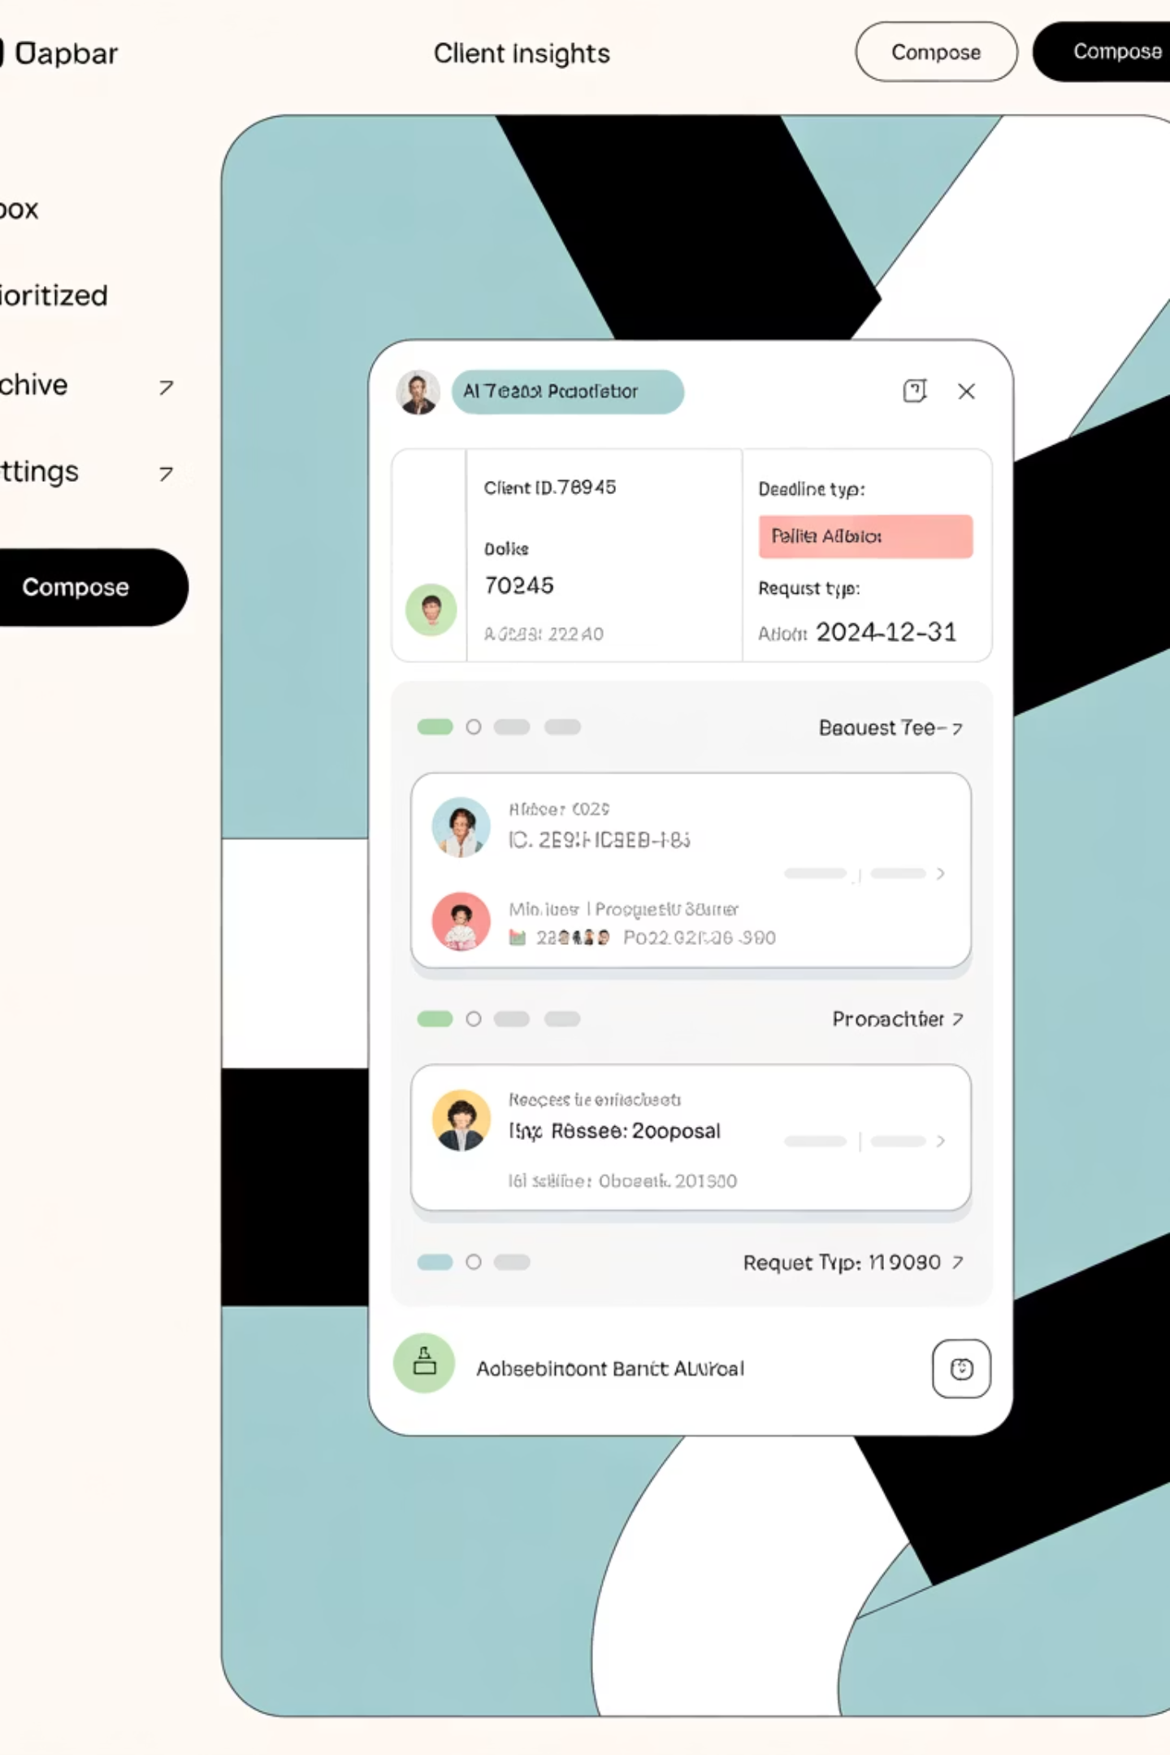
Email Understanding
Rapid Classification
Entity Extraction
Large-language models classify intent, extract entities, and detect priority in under 300 milliseconds.
Automatically identifies client IDs, deadlines, and ticket types from unstructured emails.
Priority Detection
Intelligently determines which requests need immediate attention based on content analysis.

Slide 6
Multi-System Orchestration
Pre-built connectors pull data from CRM, portfolio, Bloomberg, risk, and compliance systems, eliminating swivel-chair copy-paste operations that consume hours of staff time.

Slide 7
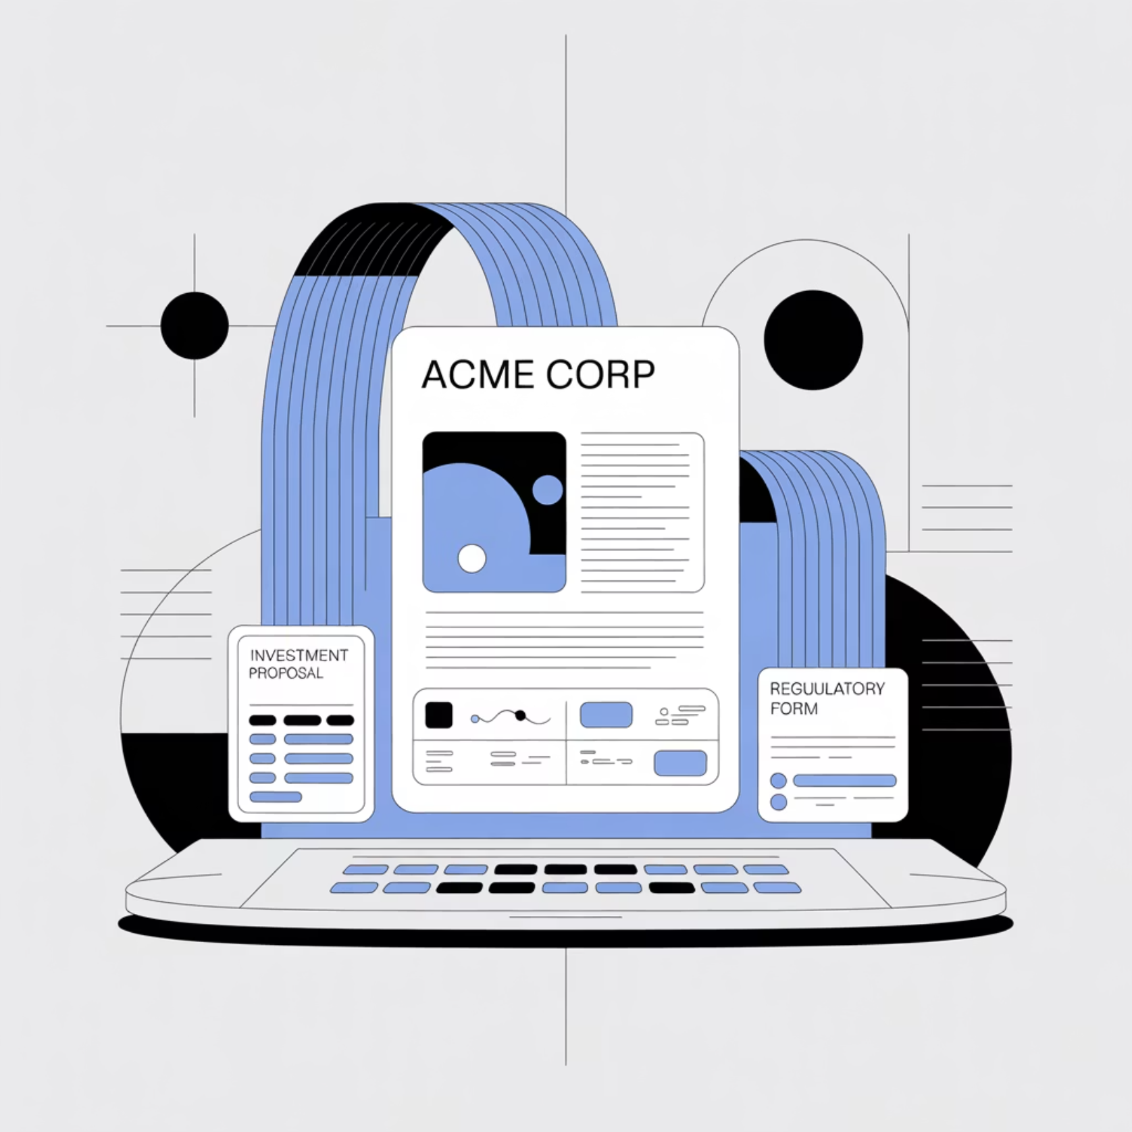
Auto-Generated Deliverables
Our AI instantly drafts key financial documents with proper formatting, required disclosures, and up-to-date data:
PowerPoint decks
Investment proposals
Client biographies
Regulatory forms

Slide 8
Role-Aware Dashboards
Purpose-built views tailored to each user's specific needs and responsibilities.
1
2
3
Advisor Support
Support Manager
Executive Director
Personal "mission control" of active requests, next actions, and AI-drafted outputs.
Real-time team health, SLA alerts, drill-downs, and workload balancing tools.
Cross-team KPIs, cost-savings metrics, capacity forecasts, and ROI analytics.

Slide 9

Benefits Across the Organization
4-6
18%
100%
Hours Saved
Reduced Turnover
Visibility
Per complex request, eliminating manual processing time
Complete transparency into workloads and SLAs
Potential decrease in annual support staff turnover

Slide 10






Our Vision for the Future
From Email Automation to Complete Workflow Operating System
Trusted AI OS
Cross-Inbox Coverage
Workflow Integration
Policy-Aware
Automate Emails
We're building the foundation for AI-powered efficiency across all regulated financial communications, delivering measurable ROI while ensuring compliance and improving client service.

